Slide 1
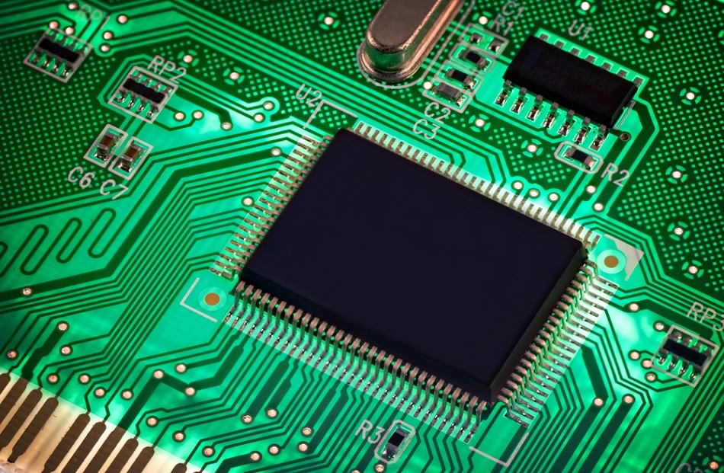
Semiconductors
dr.a.anbarasi,
Associate professor in physics
Periyar arts college,
Cuddalore.
This Photo by Unknown Author is licensed under CC BY-SA

Slide 2
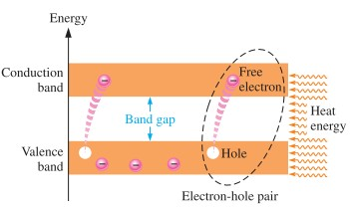
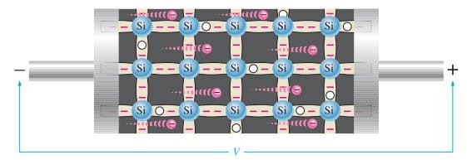
CURRENT IN SEMICONDUCTORS
Creation of electron-hole pairs in a silicon crystal.
Electrons in the conduction
band are free electrons.
Electron current in intrinsic silicon is produced by the movement of thermally generated free electrons.

Slide 3
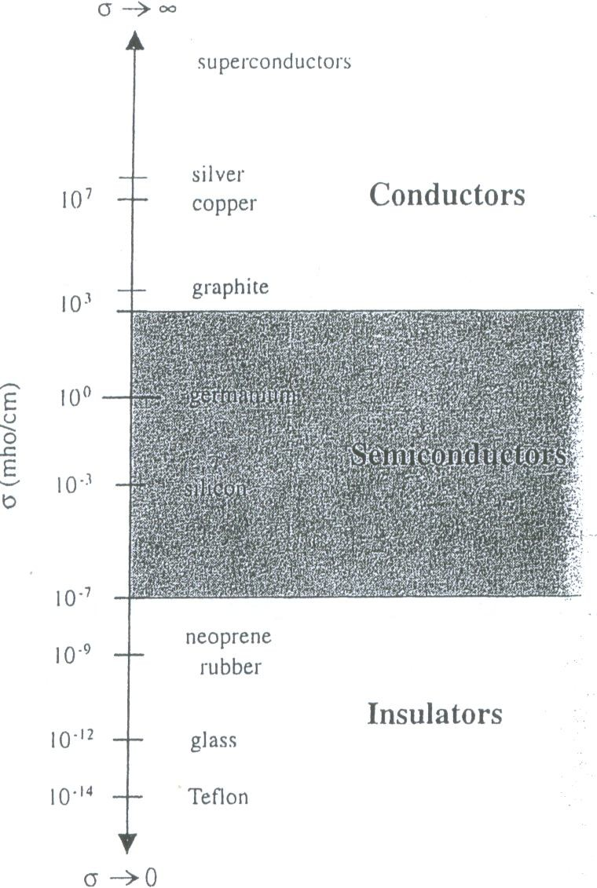
Semiconductor
Materials that permit flow of electrons are called conductors (e.g., gold, silver, copper, etc.).
Materials that block flow of electrons are called insulators (e.g., rubber, glass, Teflon, mica, etc.).
Materials whose conductivity falls between those of conductors and insulators are called semiconductors.
germanium
Semiconductors
silicon
Semiconductors are “part-time” conductors
whose conductivity can be controlled.

Slide 4
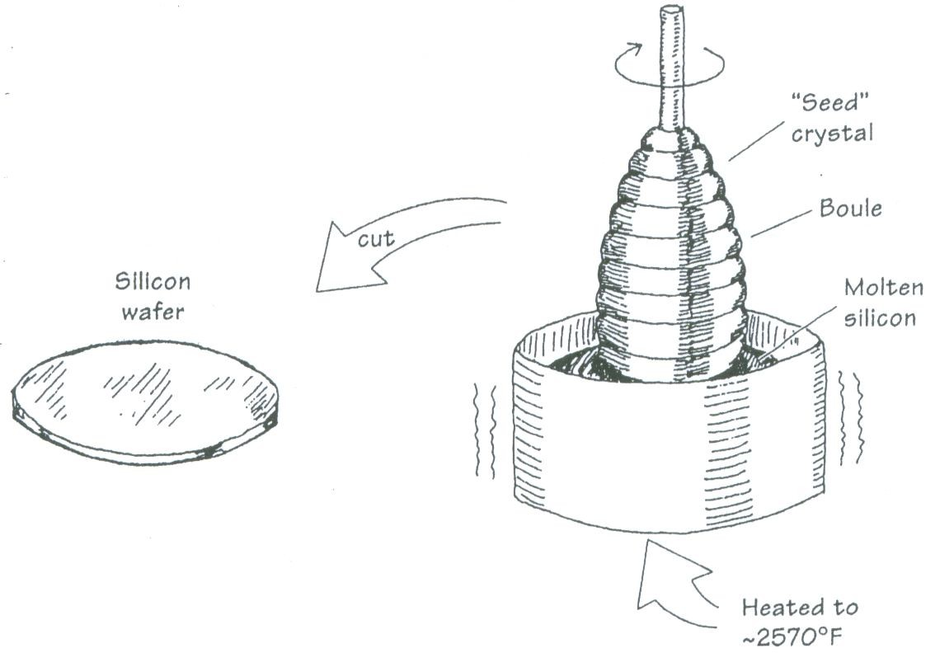
Semiconductor
Silicon is the most common material used to build semiconductor devices.
Si is the main ingredient of sand and it is estimated that a cubic mile of seawater contains 15,000 tons of Si.
Si is spun and grown into a crystalline structure and cut into wafers to make electronic devices.

Slide 5
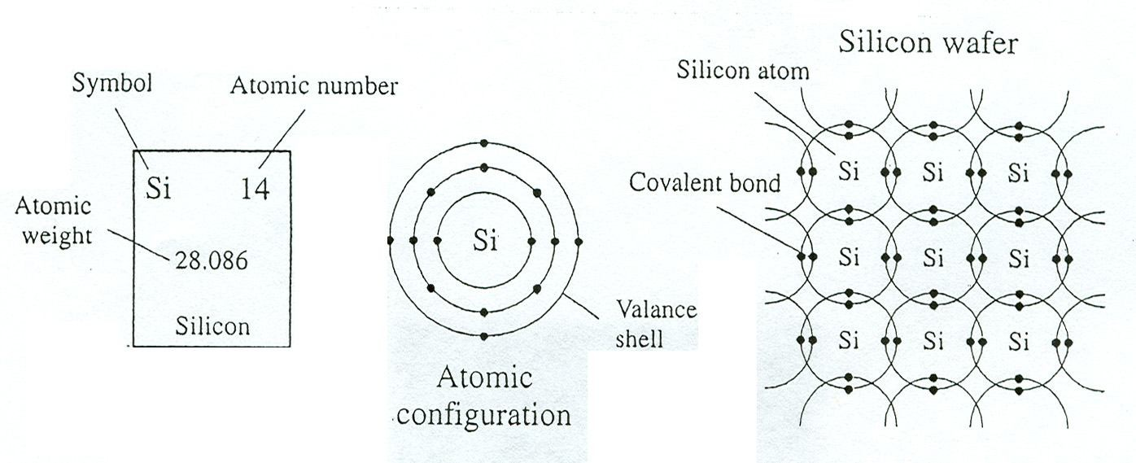
Semiconductor
Atoms in a pure silicon wafer contains four electrons in outer orbit (called valence electrons).
  Germanium is another semiconductor material with four valence electrons.
In the crystalline lattice structure of Si, the valence electrons of every Si atom are locked up in covalent bonds with the valence electrons of four neighboring Si atoms.
  In pure form, Si wafer does not contain any free charge carriers.
  An applied voltage across pure Si wafer does not yield electron flow through the wafer.
  A pure Si wafer is said to act as an insulator.
In order to make useful semiconductor devices, materials such as phosphorus (P) and boron (B) are added to Si to change Si’s conductivity.
4 valence electrons

Slide 6
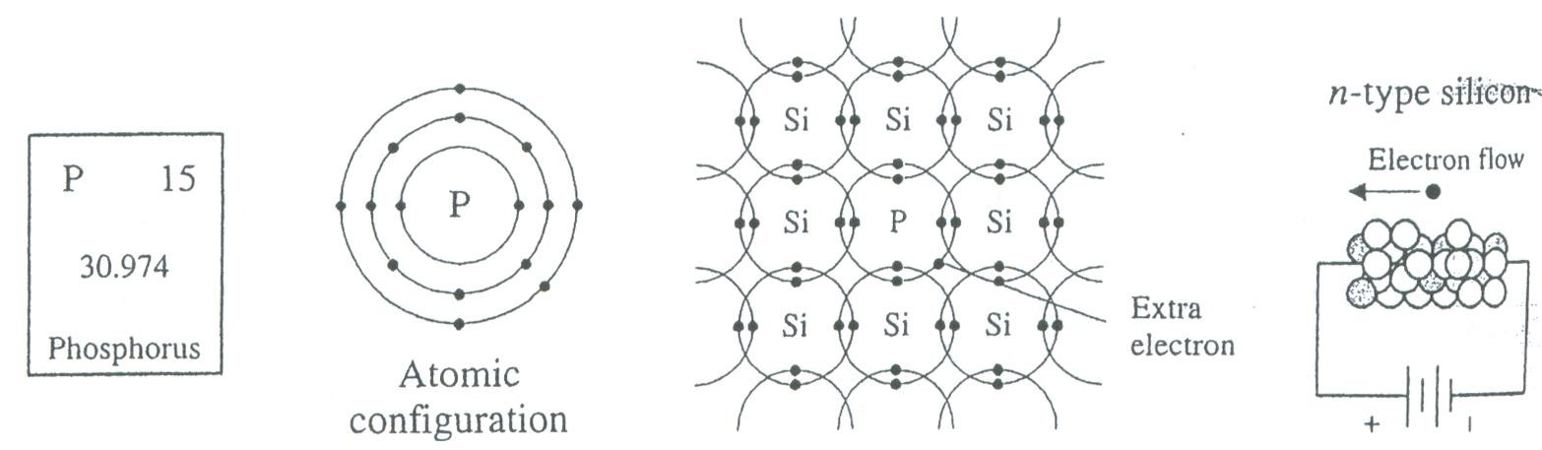
N-Type Silicon
Pentavalent impurities such as phosphorus, arsenic, antimony, and bismuth have 5 valence electrons.
When phosphorus impurity is added to Si, every phosphorus atom’s four valence electrons are locked up in covalent bond with valence electrons of four neighboring Si atoms. However, the 5th valence electron of phosphorus atom does not find a binding electron and thus remains free to float. When a voltage is applied across the silicon-phosphorus mixture, free electrons migrate toward the positive voltage end.
When phosphorus is added to Si to yield the above effect, we say that Si is doped with phosphorus. The resulting mixture is called N-type silicon (N: negative charge carrier silicon).
The pentavalent impurities are referred to as donor impurities.

Slide 7
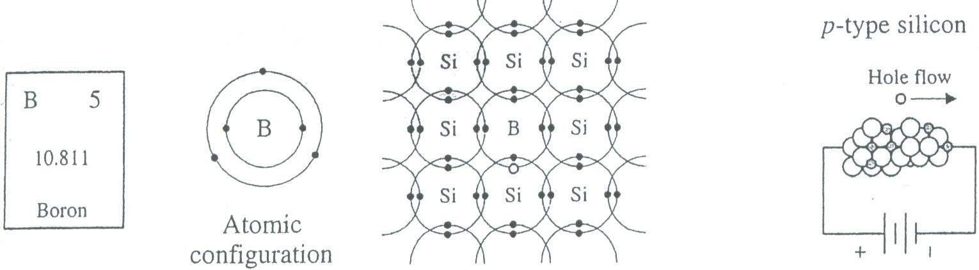
P-Type Silicon —I
Trivalent impurities e.g., boron, aluminum, indium, and gallium have 3 valence electrons.
When boron is added to Si, every boron atom’s three valence electrons are locked up in covalent bond with valence electrons of three neighboring Si atoms. However, a vacant spot “hole” is created within the covalent bond between one boron atom and a neighboring Si atom. The holes are considered to be positive charge carriers. When a voltage is applied across the silicon-boron mixture, a hole moves toward the negative voltage end while a neighboring electron fills in its place.
When boron is added to Si to yield the above effect, we say that Si is doped with boron. The resulting mixture is called P-type silicon (P: positive charge carrier silicon).
The trivalent impurities are referred to as acceptor impurities.
3 valence electrons

Slide 8
P-Type Silicon —II
The hole of boron atom points towards the negative terminal.
The electron of neighboring silicon atom points toward positive terminal.
The electron from neighboring silicon atom falls into the boron atom filling the hole in boron atom and creating a “new” hole in the silicon atom.
It appears as though a hole moves toward the negative terminal!

Slide 9
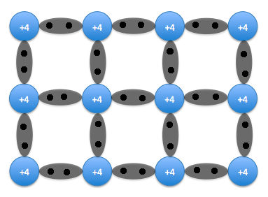
Intrinsic semiconductor
An intrinsic semiconductor, also called an undoped or I-type semiconductor is a pure semiconductor without any significant dopant species present.
The number of charge carriers is determined by the properties of the material.
This Photo by Unknown Author is licensed under CC BY-SA-NC

Slide 10
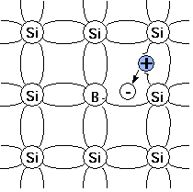
Extrinsic semiconductor
An extrinsic semiconductor is one that has been doped.
During manufacture of the semiconductor crystal ,a trace element or chemical called a doping agent has been incorporated chemically into the crystal.
This Photo by Unknown Author is licensed under CC BY-SA

Slide 11
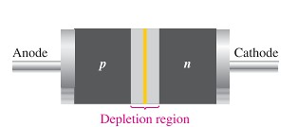

Diodes
A diode is made from a small piece of semiconductor material, usually silicon, in which half is doped as a p region and half is doped as an n region with a pn junction and depletion region in between.

Slide 12
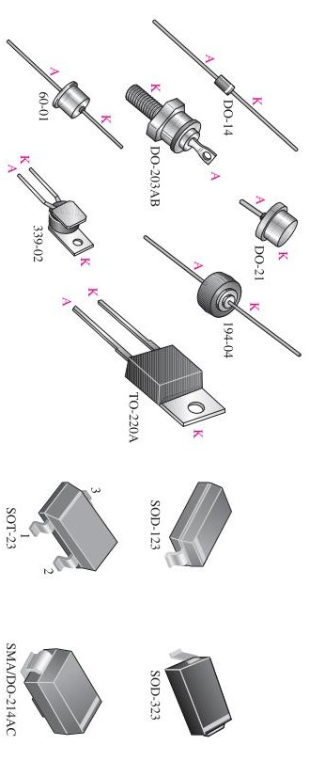
Diode Packages

Slide 13
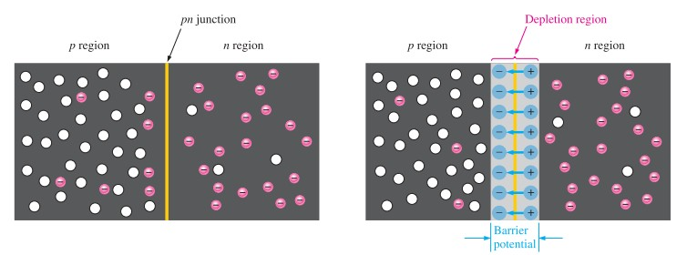
Pn junction diode
N-Type Semiconductor
  The electrons are the majority carriers and the holes are the minority. This is done by doping process.
P-Type Semiconductor
  The holes are the majority carriers and the electrons are the minority.
The basic silicon structure at the instant of junction formation showing only the majority and minority carriers.
electrons diffuse and a depletion region is formulated.

Slide 14
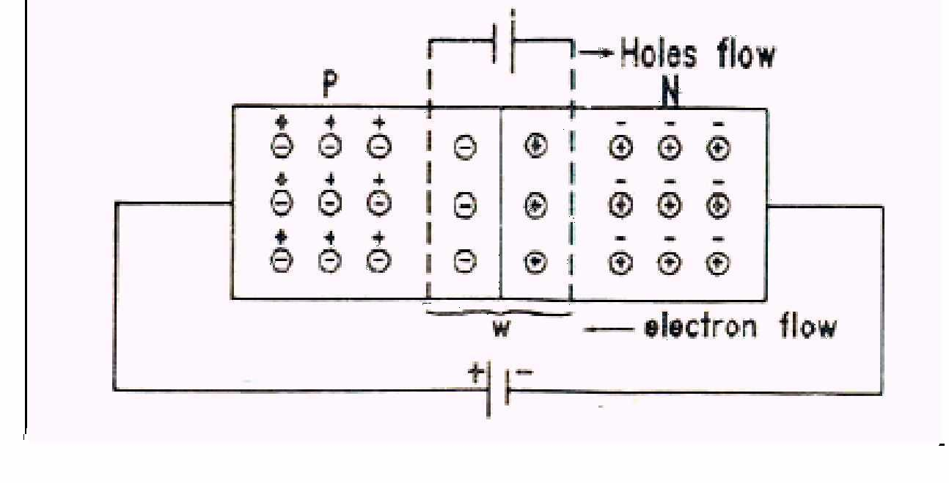
PN JUNCTION DIODES
Junction diode is formed by placing a p-type crystal in contact with n- type crystal.
These crystals are subjected at high pressure
Therefore it form a single crystal
The surface of contact of P-type and N-type crystal is called junction.
This Photo by Unknown Author is licensed under CC BY

Slide 15
Majority charge carriers,there is few minority charge carriers in each region
P region contain few electrons while the n-region contains a few holes
At the junction there is decreasing hole concentration from left to right
Holes diffuse from p-side to n-side
Electron diffuse from n-side to p-side
Holes leaving and electrons entering the p-side make it negative
Holes entering and electron leaving the n-side make it positive
It produces an electric field

Slide 16
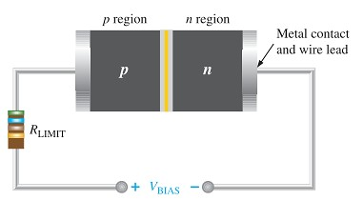
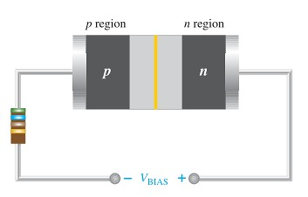
Forward & Reverse Bias
To bias a diode, you apply a dc voltage across it.
Forward bias is the condition that allows current through the pn
junction.
Reverse bias is the condition that essentially prevents current
through the diode.
Forward bias
Reverse bias

Slide 17
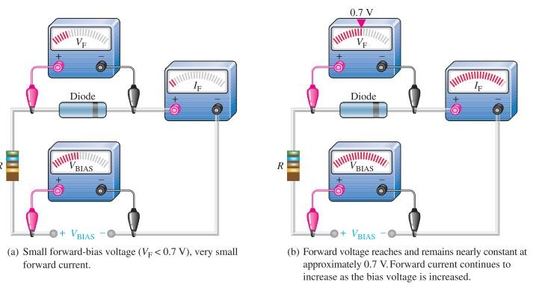
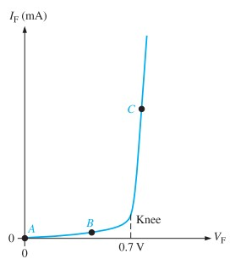
VOLTAGE-CURRENT CHARACTERISTIC OF A DIODE
V-I Characteristic for Forward Bias

Slide 18
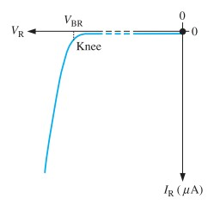
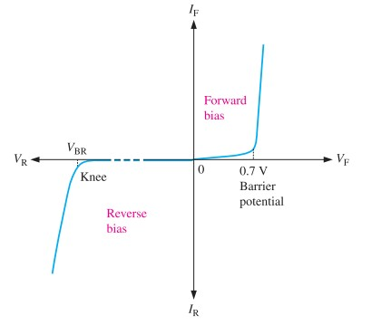
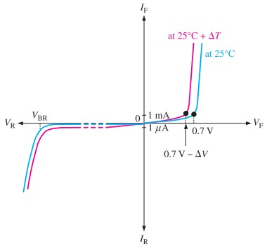
V-I Characteristic for Reverse Bias
Complete V-I Characteristic
Temperature Effect

Slide 19
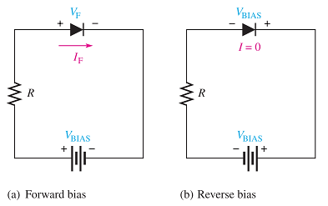
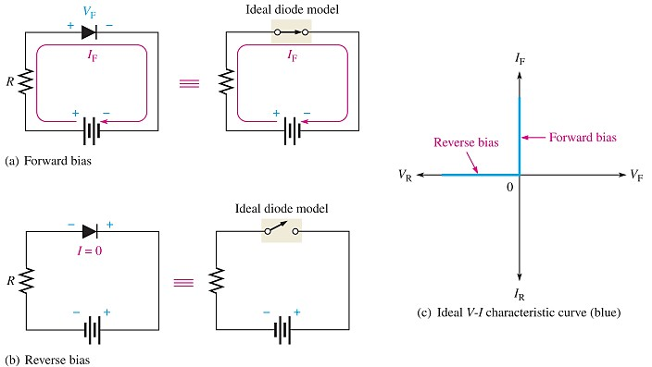


DIODE MODELS
Bias Connections
1. The Ideal Diode Model

Slide 20
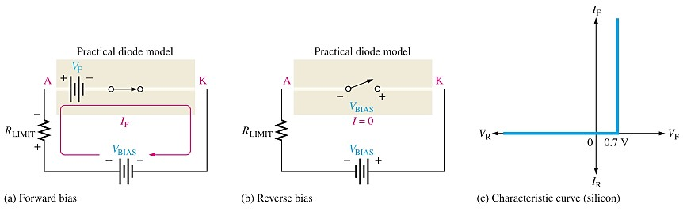




2. The Practical Diode Model

Slide 21
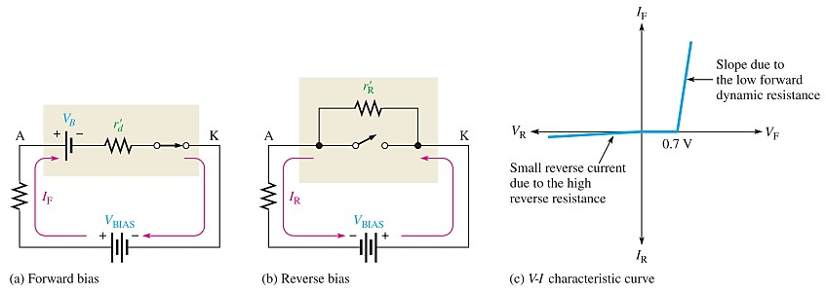

DIODE MODELS..
© Ahmad El-Banna
3. The Complete Diode Model
I_{R} : Reverse (leakage) current → diode datasheet
V_{R} = I_{R} r’_{R}

Slide 22

thank you
This Photo by Unknown Author is licensed under CC BY-SA

